Slide 1
Unit 4
Helper applications: CGI; PERL, JAVA, JAVA SRIPTS, PHP, ASP, .NET Applications

Slide 2
Common Gateway Interface (CGI)
Common Gateway Interface (CGI) is a standard method used to generate dynamic content on Web pages and Web applications. CGI, when implemented on a Web server, provides an interface between the Web server and programs that generate the Web content
The Common Gateway Interface, or CGI, is a set of standards that define how information is exchanged between the web server and a custom script
The Common Gateway Interface, or CGI, is a standard for external gateway programs to interface with information servers such as HTTP servers
The current version is CGI/1.1 and CGI/1.2 is under progress

Slide 3
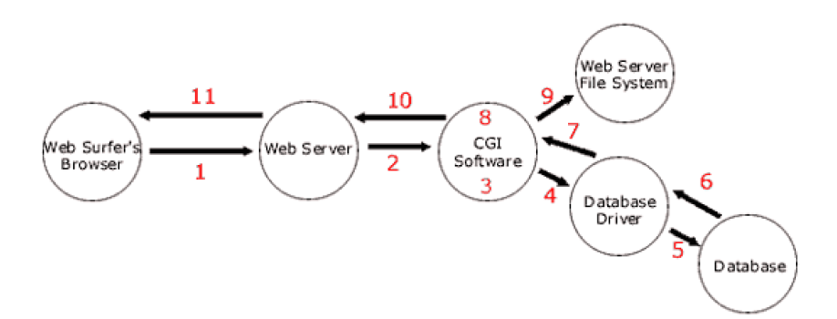
How CGI Scripts Works
The Web surfer fills out a form and clicks, “Submit.” The information in the form is sent over the Internet to the Web server.
The Web server “grabs” the information from the form and passes it to the CGI software

Slide 4
Contd..
The CGI software performs whatever validation of this information that is required. For instance, it might check to see if an e-mail address is valid. If this is a database program, the CGI software prepares a database statement to either add, edit, or delete information from the database.
The CGI software then executes the prepared database statement, which is passed to the database driver.
The database driver acts as a middleman and performs the requested action on the database itself.
The results of the database action are then passed back to the database driver.

Slide 5
Contd…
The database driver sends the information from the database to the CGI software.
The CGI software takes the information from the database and manipulates it into the format that is desired.
If any static HTML pages need to be created, the CGI program accesses the Web server computer’s file system and reads, writes, and/or edits files
The CGI software then sends the result it wants the Web surfer’s browser to see back to the Web server.
The Web server sends the result it got from the CGI software back to the Web surfer’s browser.

Slide 6
CGI Real-life Examples
Search Engine
Page-hit Counter
Student Registration
On-line Booking of Tickets
On-line Purchase of Items
E-mail Gateways
Feedback Scripts
Web-based Games

